Slide 1

ENHANCING WOMEN SAFETY USING GPS AND REAL-TIME MONITORING USING MACHINE LEARNING
By
KOMICHETTY BHAVYASREE : 21BF1A3235
R.SREE SAI MANASA : 21BF1A3251
BODIREDDY VIJAY : 21BF1A3208
S.PARTHASARADHI : 21BF1A3256
D.HEMANTH REDDY : 21BF1A3216
Under the guidance of
E.STUTI (Ph.D)
Assistant Professor
DEPARTMENT OF COMPUTER SCIENCE AND ENGINEERING (DataScience)
SRI VENKATESWARA COLLEGE OF ENGINEERING
(Autonomous)
Karakambadi Road, Tirupati-517502
2021-2025

Slide 2
OUTLINE
Abstract
Introduction
Literature Survey
Existing system
Disadvantages
Proposed system
Problem Statement
System Architecture
Advantages
System Requirements
Modules
UML Diagrams
Screen Shots
Conclusion

Slide 3
ABSTRACT
Women’s safety in public and private transportation remains a critical issue. The proposed system leverages GPS and machine learning to provide real-time monitoring and safety alerts during travel. The application tracks routes and monitors deviations from planned paths, sending emergency alerts to predefined contacts if necessary. Additionally, it integrates a crime rate analysis feature, utilizing a dataset of crime rates across Indian cities to inform users about safety levels in their location. The model uses the dataset to predict and display crime risk levels in real-time, enhancing situational awareness and personal security.
Keywords: Women Safety, GPS Tracking, Crime Rate Analysis, Machine Learning, Real-Time Monitoring

Slide 4
INTRODUCTION
The rising incidents of crimes against women highlight the urgent need for innovative safety solutions. Safe Ride is a mobile application designed to ensure safer travel by:
Providing route tracking with deviation alerts.
Sending emergency notifications to trusted contacts.
Displaying crime rates of cities using location data.
Key Objectives:
Utilize GPS for real-time route tracking.
Analyze and display city-wise crime rates.
Develop an ML model to predict high-risk areas based on historical crime data.
Ensure user-friendly interaction and proactive safety features.

Slide 5
Literature Survey
S.NO | Title | Author | ML Model Used | Techniques Used | Accuracy
1 | Crime Rate Prediction using Machine Learning | Priyanshu Ladha, Nitya Patyal | K-Nearest Neighbor (KNN), Support Vector Machine (SVM), Decision Tree | Classification algorithms applied to crime statistics and demographic data to categorize regions into high, medium, and low crime rates. | No Specific accuracy.
2 | Ranking the Locations and Predicting Future Crime Occurrence by Retrieving News from Different Bangla Online Newspapers | Jumman Hossain, Rajib Chandra Das, Md. Ruhul Amin, Md. Saiful Islam | Naive Bayes Classifier | Crawling crime data from online newspapers, keyword extraction, location finding algorithm, cosine similarity, and a custom crime prediction model. | Studies using machine learning techniques on Bangla news have shown varying accuracies, ranging from around 75% to 90% for crime classification.
3 | Crime Rate Prediction Using ML | Prajwal R | Statistical models using weighted moving average and functional statistics based on previous year's crime data for Indian states. | Machine learning algorithms applied to crime data to forecast crime rates in specific regions. | accuracy rates ranging from 39% to 90%

Slide 6
EXISTING SYSTEM
Current systems offer:
GPS tracking for navigation.
SOS alerts with limited customization.
General safety tips without localized insights.
Panic Buttons or SOS Alerts
Government crime data dashboards exist but are not integrated with real-time user location.

Slide 7
DISADVANTAGES
Lack of crime rate analysis for locations.
No prediction models for high-risk areas.
Limited automation in emergency response mechanisms.
No Usage of advanced AI features and Machine Learning Algorithms.
Sole reliance on manual inputs from users.
High false alarm rates.

Slide 8
PROPOSED SYSTEM
The Women Safety Crime Risk Prediction System is an AI-powered web application designed to enhance safety awareness for women by providing real-time risk levels based on their current location. The system gathers location data, fetches crime statistics, and uses a trained machine learning model to predict risk levels (Low, Medium, High). This ensures women can make informed decisions when traveling or moving through different areas.

Slide 9
PROBLEM STATEMENT
Women face significant safety concerns during travel, especially in unfamiliar areas. Traditional solutions lack real-time monitoring and fail to provide contextual information like crime rates. This project addresses the need for an integrated system combining route tracking with location-based safety insights.

Slide 10
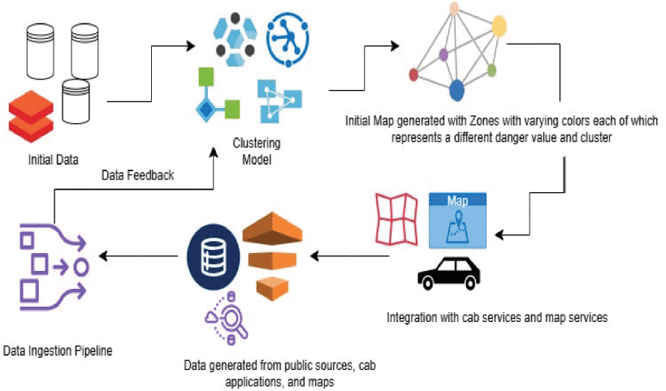
SYSTEM ARCHITECTURE
Diagram illustrating the architecture
Modules: Data preprocessing, feature extraction, model training, prediction, visualization
Output: Predicted crime rates with visual representation and GPS tracking

Slide 11
ADVANTAGES
Proactive safety monitoring with predictive insights.
Accessible across devices via a web interface.
Automated alerts reduce reliance on manual inputs.
Crime rate visualization provides informed decision-making.
Reduction of False Alarm rates.

Slide 12
SYSTEM REQUIREMENTS
Hardware Requirements :
Processor: Minimum Quad-Core (Intel i5 or equivalent)
RAM: 16 GB for optimal model training and application performance
Storage: 1 TB SSD or higher for dataset storage and fast retrieval
GPU: T4 Recommended for training machine learning models

Slide 13
SYSTEM REQUIREMENTS
Software Requirement:
Programming Languages: Python (Flask/Django), JavaScript (React/Angular)
Machine Learning Frameworks: TensorFlow, Scikit-learn
Database: MongoDB/PostgreSQL
Libraries/Tools: Pandas, NumPy, OpenCV

Slide 14
MODULES FOR EWS-GPS&ML
Data Preprocessing :
Handling missing data, normalization
Processing GPS and Crime rates data.
Detection :
Training machine learning models (e.g., Random Forest, Decision Tree)
Prediction of crime rates based on location and historical data
Location and Route detection using the GPS module
Visualization :
Interactive web-based interface
City-wise crime heatmaps and charts
Alerts Services Prompt.

Slide 15
PSEUDO CODE FOR EWS-GPS&ML
Backend Flask Structure:
•app.py: Main file handling routing, model loading, and prediction
•/templates: Contains HTML pages like index.html, result.html
•/static: CSS and JS files
•model/random_forest_model.pkl: Pretrained model for prediction
Sample Flask Code:
python
CopyEdit
@app.route("/predict", methods=["POST"])
def predict():
city = request.form.get("city")
state = request.form.get("state")
data = get_crime_data(city, state)
prediction = model.predict([data])[0]
return render_template("result.html", risk=prediction)
Frontend Location Detection:
javascript
CopyEdit
navigator.geolocation.getCurrentPosition((position) => {
const lat = position.coords.latitude;
const lon = position.coords.longitude;
// Call OpenStreetMap API to get city/state from lat/lon
});

Slide 16
SOFTWARE ARCHITECTURE WITH UML DIAGRAMS
The Unified Modelling Language (UML) is a standard language for specifying, visualizing, constructing, and documenting the artifacts of software systems, as well as for business modeling and other non-software systems. The UML represents a collection of best engineering practices that have proven successful in the modeling of large and complex systems. In this project ,basic UML diagrams have been explained
Use Case Diagram
Class Diagram
Sequence Diagram
Collaboration Diagram
State Machine Diagram
Activity Diagram
Component Diagram
Deployment Diagram

Slide 17
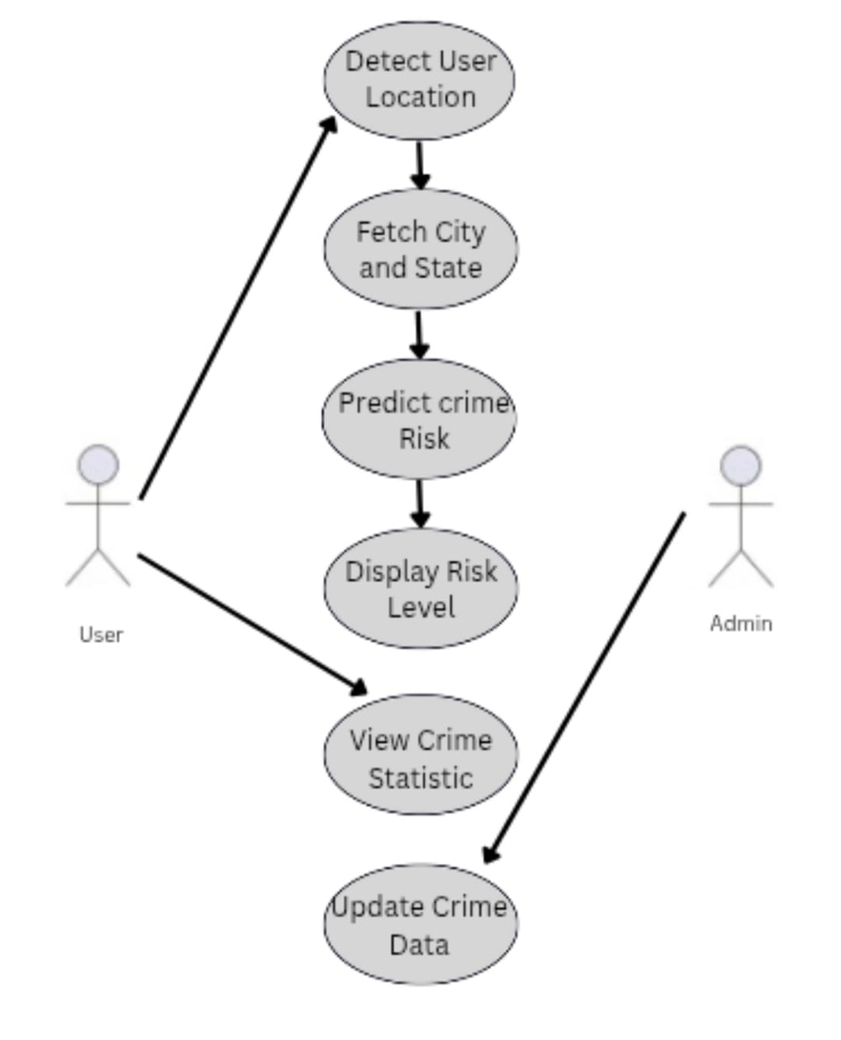
SOFTWARE ARCHITECTURE (USECASE DIAGRAM)
Usecase Diagram :
This Use Case UML diagram describes a system that provides crime risk information to users based on their location and allows administrators to manage the underlying crime data.
Relationships:
User: Initiates location detection, receives risk level, and views statistics.
Admin: Can update crime data and view statistics.

Slide 18
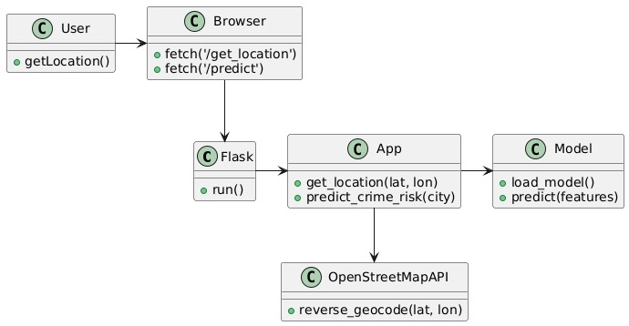
SOFTWARE ARCHITECTURE (CLASS DIAGRAM)
Class Diagram :
Here,The User interacts with the Browser to trigger geolocation and crime prediction requests. The Browser sends these requests to the Flask application. Flask's App component handles these requests, utilizing the OpenStreetMap API for reverse geocoding and a Model for crime risk prediction.

Slide 19
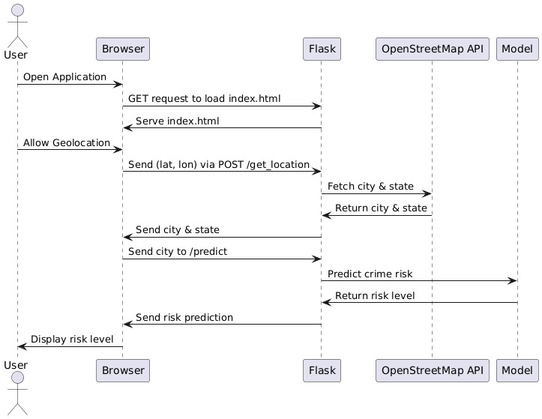
SOFTWARE ARCHITECTURE (SEQUENCE DIAGRAM)
Sequence Diagram :
This UML sequence diagram illustrates the user opens a web application, allows geolocation, and their coordinates are sent to a Flask backend. Flask then uses OpenStreetMap API to fetch the city and state, sends the city to a prediction model, receives a crime risk prediction, and finally sends this prediction back to the browser for display to the user.

Slide 20
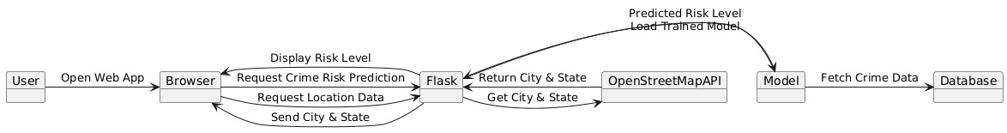
SOFTWARE ARCHITECTURE (COLLABORATION DIAGRAM)
Collaboration Diagram :
This diagram illustrates the flow of a crime risk prediction web application where the user interacts through a browser, the Flask backend retrieves location data via OpenStreetMap and uses a trained model (fed by a database) to predict and display the risk level.

Slide 21
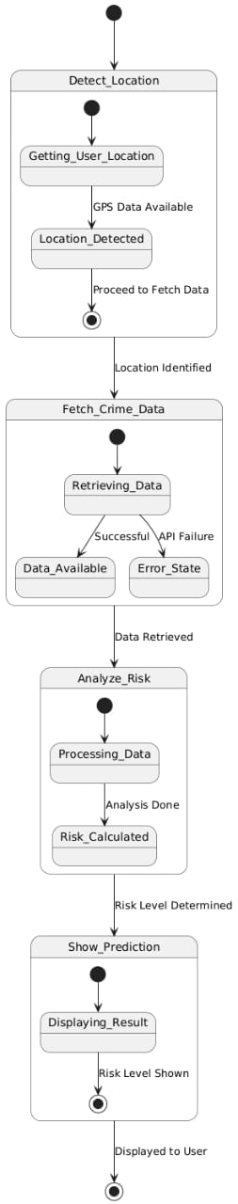
SOFTWARE ARCHITECTURE (STATE MACHINE DIAGRAM)
State Machine Diagram :
This UML state machine diagram illustrates the workflow of a crime risk prediction system, focusing on the states and transitions of the system during the prediction process.

Slide 22
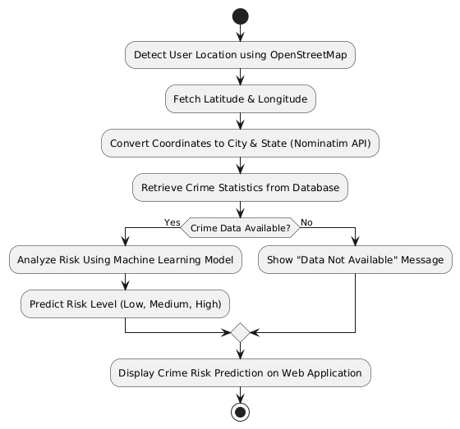
SOFTWARE ARCHITECTURE (ACTIVITY DIAGRAM)
Activity Diagram :
This UML activity diagram outlines the workflow of a crime risk prediction system, focusing on the sequence of actions and decisions involved.

Slide 23
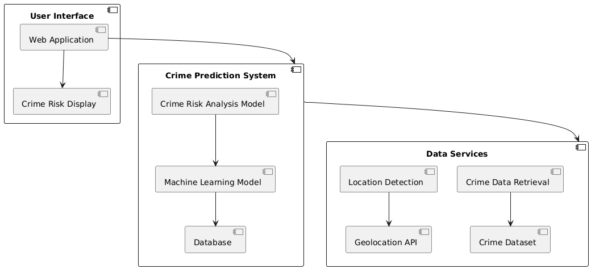
SOFTWARE ARCHITECTURE (COMPONENT DIAGRAM)
Component Diagram :
This component diagram illustrates the high-level architecture of a Crime Prediction System.The arrows indicate dependencies and relationships between these components. The User Interface interacts with the Crime Prediction System to get results, and the Crime Prediction System relies on Data Services for location information and crime data.

Slide 24
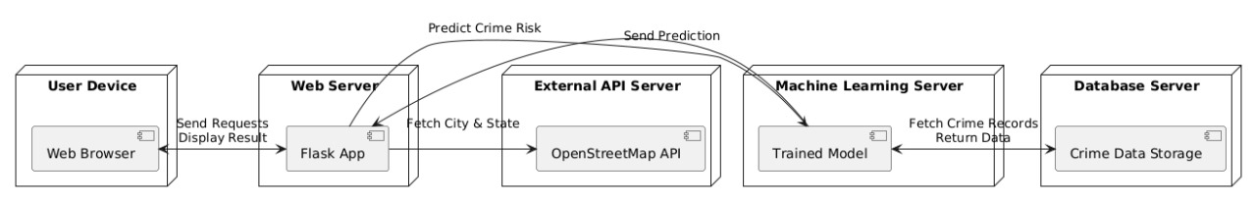
SOFTWARE ARCHITECTURE (DEPLOYMENT DIAGRAM)
Deployment Diagram :
This deployment diagram illustrates the physical architecture of the crime prediction application. The User Device, running a Web Browser, interacts with the Web Server where the Flask App is deployed. The Flask app communicates with an External API Server hosting the OpenStreetMap API to fetch location data (city and state). The Flask app also sends data to the Machine Learning Server, which utilizes a Trained Model to predict crime risk. This model fetches crime records from the Database Server that houses the Crime Data Storage. The predicted crime risk is then sent back to the Web Server and finally displayed on the user's Web Browser.

Slide 25
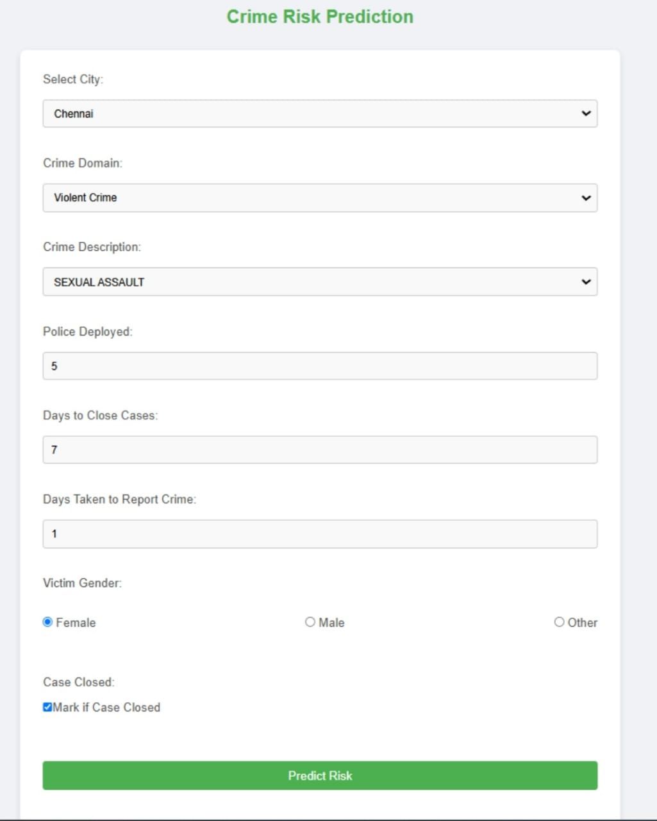
PROJECT EXECUTION THROUGH SCREENSHOTS
Index Page: this is the landing page

Slide 26
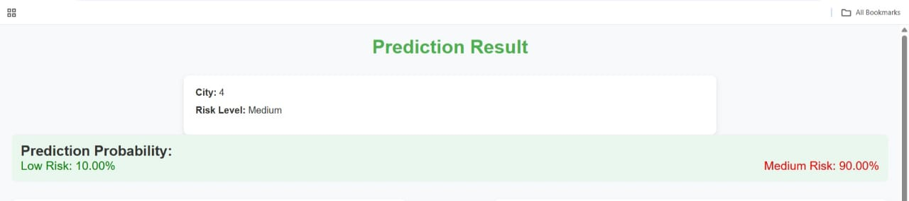
PROJECT EXECUTION THROUGH SCREENSHOTS
Prediction Page:

Slide 27
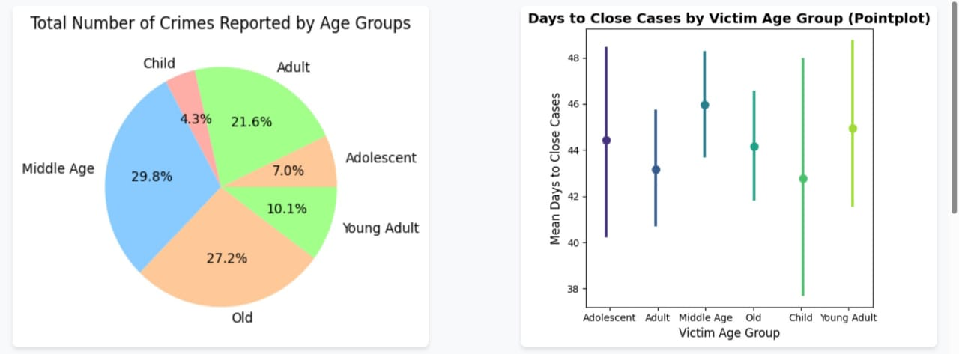
PROJECT EXECUTION THROUGH SCREENSHOTS
Prediction Page:

Slide 28
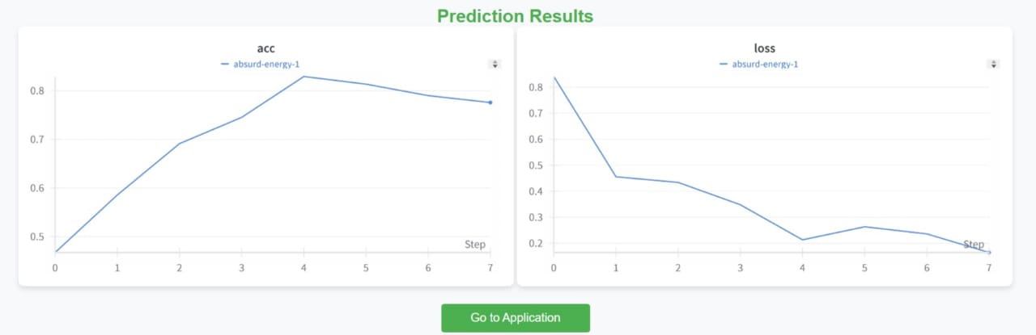
PROJECT EXECUTION THROUGH SCREENSHOTS
Results Page:

Slide 29
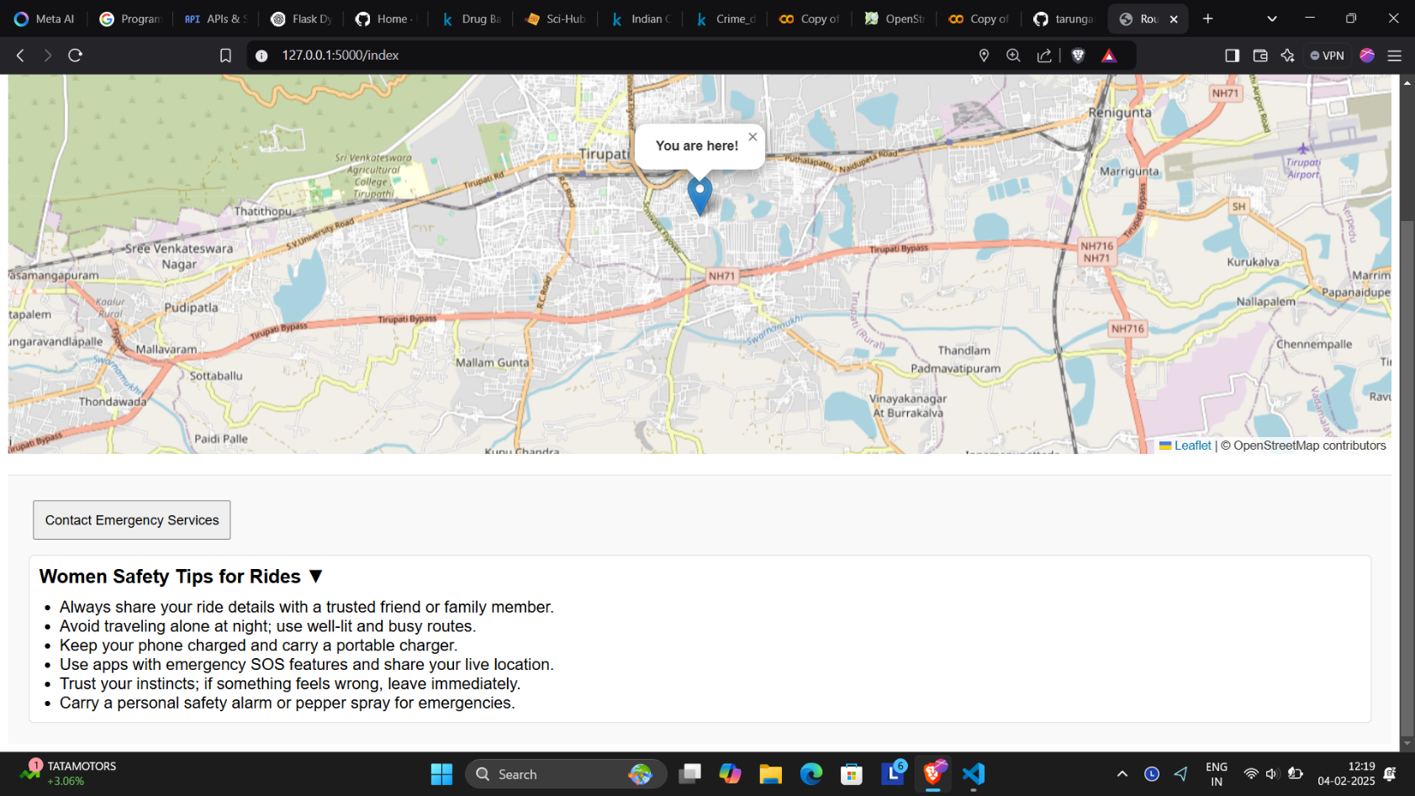
PROJECT EXECUTION THROUGH SCREENSHOTS
Tracking Page:

Slide 30
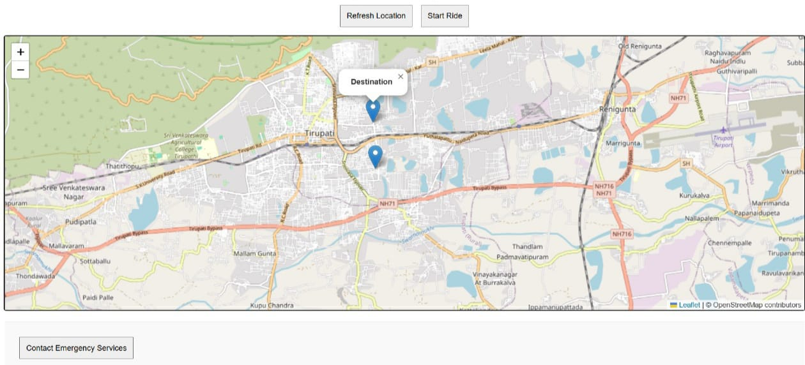
PROJECT EXECUTION THROUGH SCREENSHOTS
Destination Page:

Slide 31
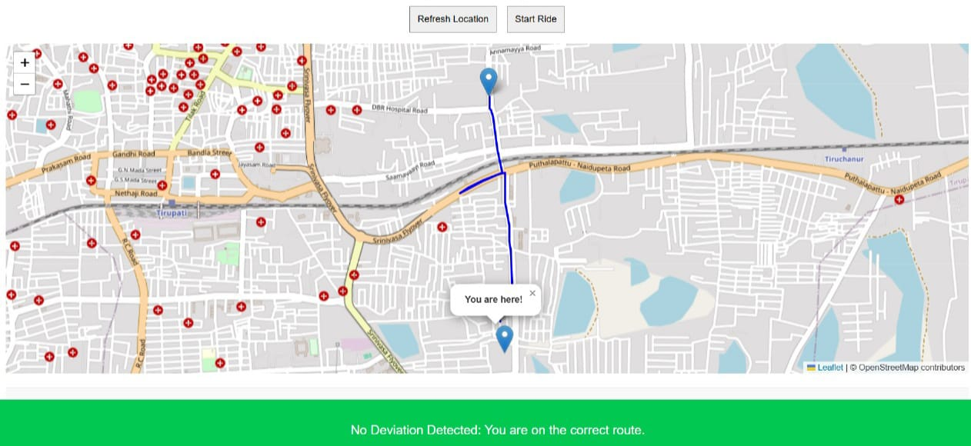
PROJECT EXECUTION THROUGH SCREENSHOTS
Route planning Page:

Slide 32
CONCLUSION
We proposed a crime risk prediction system that leverages location detection and machine learning to enhance women's safety.
By integrating OpenStreetMap for real-time location tracking and a trained ML model for crime analysis, our system provides users with risk assessments categorized as low, medium, or high.
The web-based platform allows users to check crime risk without requiring manual data input, improving accessibility and usability.
Additionally, the incorporation of real-time crime data ensures up-to-date predictions, enabling proactive safety measures.

Slide 33
FUTURE ENHANCEMENT
This work lays a strong foundation for further research and development. Here are the proposed extensions:
1.Real-Time Crime Updates
Integration with government portals or APIs to fetch live crime data.
2.Mobile App Version
Deploying the system as an Android/iOS app with offline fallback support.
3.Crowdsourced Reporting
Allow users to report incidents anonymously, enhancing community-based data collection.

Slide 34
REFERENCES
1.Choudhary, A., Jindal, A., & Singh, P. (2021). Machine Learning Techniques for Crime Prediction and Classification: A Comparative Study. International Journal of Computer Applications.
2.Kumar, S., & Rani, M. (2022). A Review on Women Safety Apps and Crime Mapping Tools. Journal of Emerging Technologies and Innovative Research (JETIR).
3.Patel, R., & Shah, H. (2021). Crime Analysis using Machine Learning Algorithms. International Research Journal of Engineering and Technology (IRJET).
4.Sharma, V., & Jain, K. (2022). Smart Women Safety System Using GPS and Android App. International Journal of Scientific Research in Computer Science and Engineering.
5.Prakash, M., & Anjali, M. (2023). Crime Rate Analysis in India Using Machine Learning. Journal of Advanced Research in Dynamical and Control Systems.

Slide 35


